Slide 1


CHATBOT SONGS RECOMMENDATION SYSTEM
K.SHARVANI -2103A54024
B.NISHMITHA-2103A54004
V.VARSHITHA-2103A54040

Slide 2
CONTENTS :
ABSTRACT
01
MOTIVATION AND BACKGROUND
04
02
OBJECTIVES
03
INTRODUCTION

Slide 3
CONTENTS :
LITERATURE
06
ELEMENTS USED IN THE PROJECT
05
07
SCREENS, TEST CASES AND RESULTS
08
CONCLUSION

Slide 4
INTRODUCTION
In a world where music is a universal language that speaks to our hearts and emotions, the power of emojis to enhance your musical experiences. emojis are more than a digital language;they are universal experession of emotions, transending linguistic barriers and cultures. our project aims to leverage this universal emotional language to discover the differents songs and enjoying the music .
imagine a worldwhere you can effortlessly find the perfect song to match your mood by simply selecting an emoji that represents how you feel at that moment. these emojis will recommends songs that resonate your emotions

Slide 5
OBJECTIVE
The objective of this project to develop a user-friendly and engaging song retravel system that
everages emojis to provide a novel and intuitive interface for accessing songs from a database.
Enhance User Experience
Language-Barrier Removal
Personalization
Efficiency and Accessibility
Innovation
Demonstrate Java and Eclipse

Slide 6
ELEMENTS USED IN THE PROJECT
JTextField
JLabel
JButton
JRadiobutton
Jpanel
Eclipse IDE
Emoji
Music Database
Emoji-to Emotion Mapping
Recommendation Algorithm
Metadata
Database Query

Slide 7
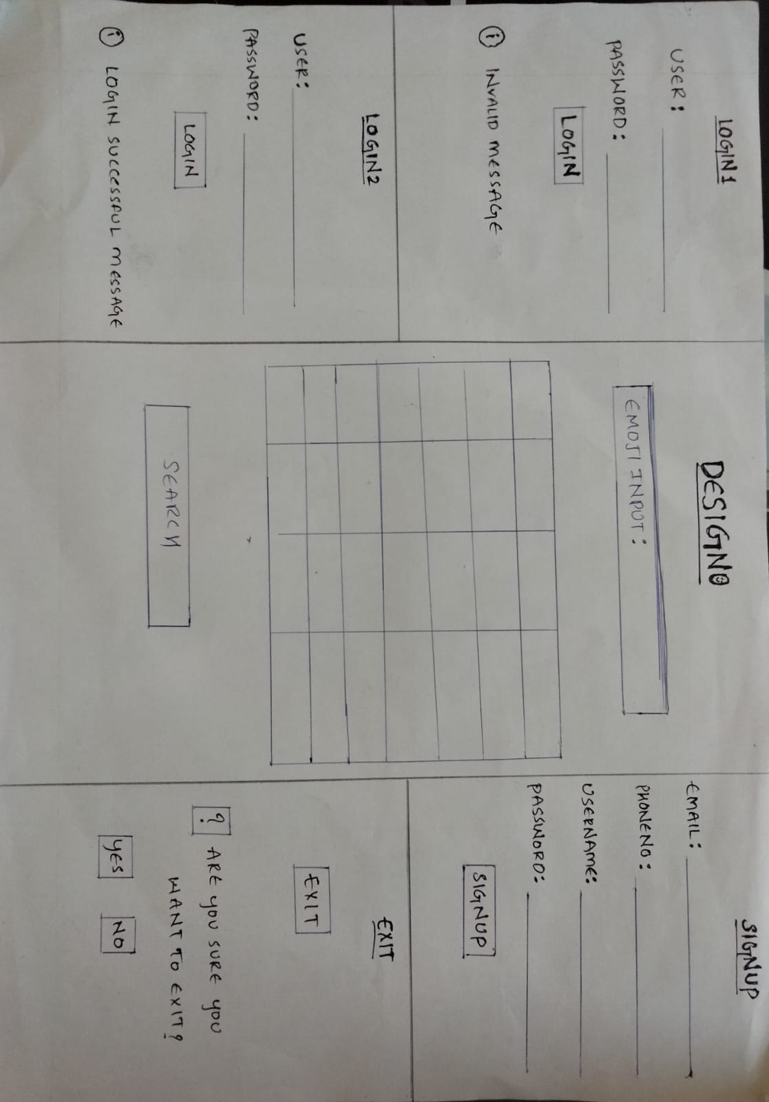
ELEMENTS USED IN THE PROJECT
The existing system of this project is a chatbot where we chat with AI to recommend songs related to our description given in the chatbot but in our project, the special key is an emoji where we can give an emoji as input. It will give us that particular emoji-related songs as our result.

Slide 8

SCREENS
SCREEN 1 : HOMEPAGE

Slide 9
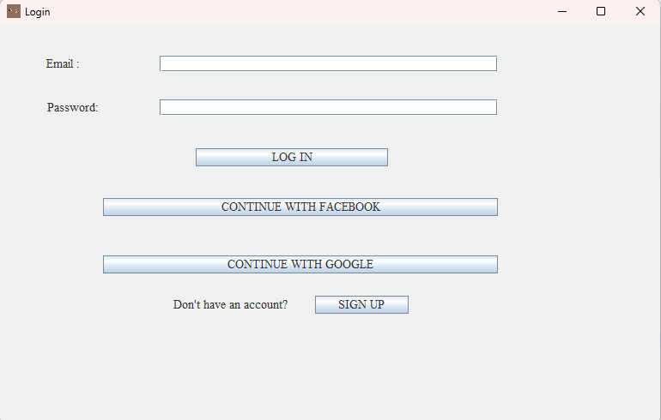
SCREEN 2: LOGINPAGE

Slide 10
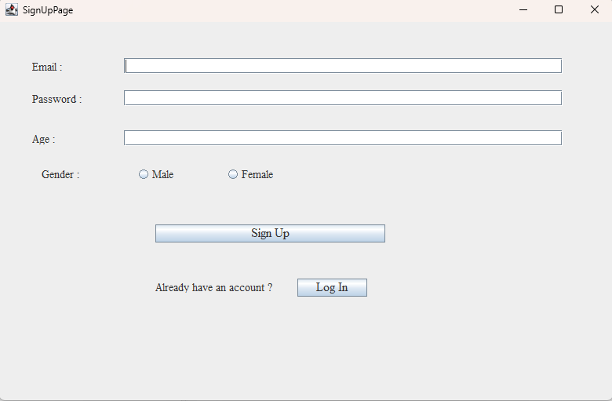
SCREEN 3: SIGNUP PAGE

Slide 11
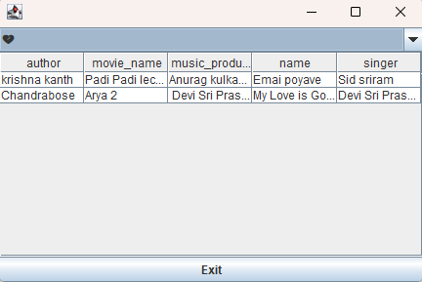
SCREEN 4:DISPLAY PAGE

Slide 12
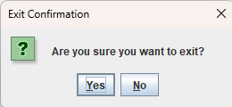
SCREEN 5:EXIT PAGE

Slide 13
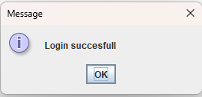
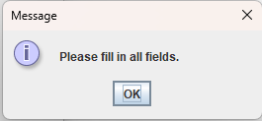
TEST CASES

Slide 14
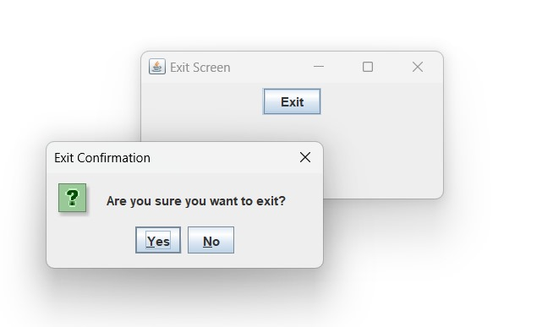
TEST CASES

Slide 15
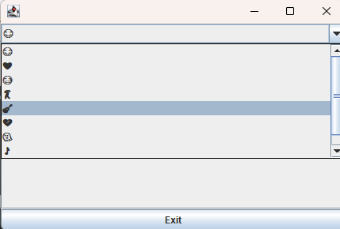
RESULT

Slide 16
CONCLUSION
The Java-Based Chatbot songs recommendation system represents an innovative and user friendly interface for emoji input, an emotion-to-song matching engine, a music database, a recommendation algorithm, and user profile management. The system allows users to select emojis representing their mood or emotions, and, based on these selections, it provides a curated list of song recommendations. Users can effortlessly access personalized song recommendations. Moreover, by incorporating q well-structured song that align with users chosen emojis. This system is a valuable addition to any music player application. It allows users to search for songs in a fun and unique way, and it helps users to discover new songs that they might not have otherwise found. The system is also easy to use and implements well using java swing application in eclipse.

Slide 17
THANK YOU

